Slide 1
2024 Media Kit
Contact: advertising@thebulletin.org

Slide 2
Who we are
The Bulletin of the Atomic Scientists is a nonprofit that provides authoritative reporting on nuclear risk, climate change, and disruptive technologies, such as advancements in bioresearch and artificial intelligence. What connects these issues is a driving belief that because humans created them, we can control them.
In 1945, the Bulletin was founded by Manhattan Project scientists who “could not remain aloof to the consequences of their work.” Albert Einstein established the Bulletin’s Board of Sponsors with J. Robert Oppenheimer as its first chair. Nearly 80 years later, the Bulletin continues to equip the public, policymakers, and scientists with the information needed to reduce man-made threats to human existence.
Learn more at www.thebulletin.org
J. Robert Oppenheimer, the first chair of the Bulletin’s Board of Sponsors.
Notes:
• A nonprofit dedicated to reporting on nuclear risk, climate change, and disruptive technologies
• Founded by scientists who helped build the world’s first atomic bombs.
• Early leadership included the likes of Albert Einstein and Robert Oppenheimer.
• Nearly 80 years later, we are continuing to uphold the vision our founders had for a safer and more secure future.

Slide 3
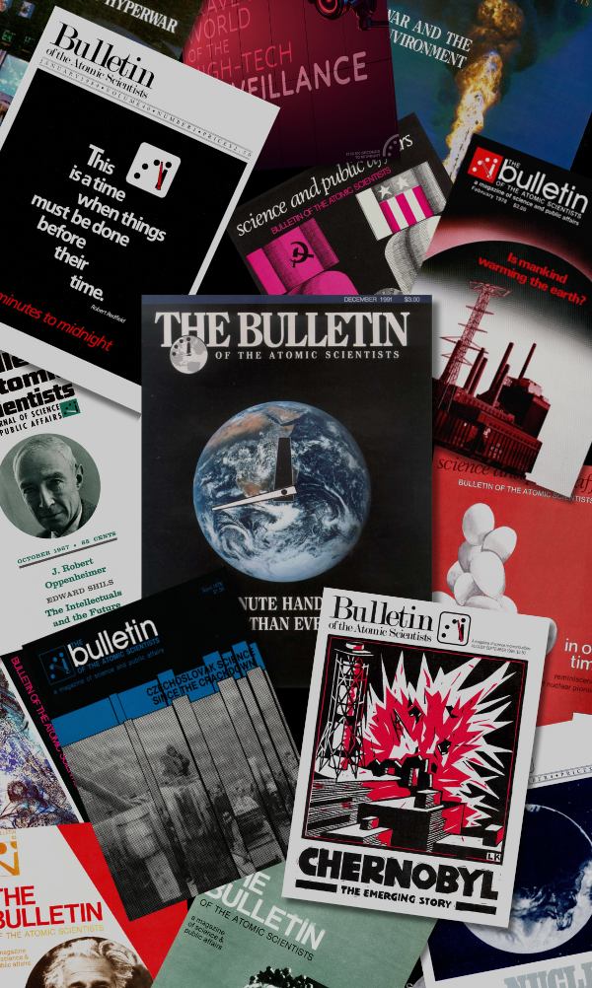
Why advertise with the Bulletin?
Our award-winning journalism breaks news, ignites conversations, and challenges world leaders. Since 1945, the Bulletin has provided in-depth reporting and analysis from trusted experts. With a legacy stretching back to the creation of the atomic bomb, the Bulletin is a long-respected publication with a reputation for providing readers with information they can trust. Today, the Bulletin reaches more than a million monthly readers from around the world on our website and engages many more across events, other digital platforms, and our subscription magazine.
Magazine covers from the Bulletin’s archives.
Notes:
• Award winning journalism breaks news and ignites conversations
• In our surveys, our most loyal readers have indiciated that they view the Bulletin as a highly trustworthy source
• The Bulletin is also a long-respected organization, that is regularly sited in outlets like The Atlantic, The Washington Post, The New York Times, and more.
• We also have an ever-expanding audience of informed citizens from around the world.

Slide 4
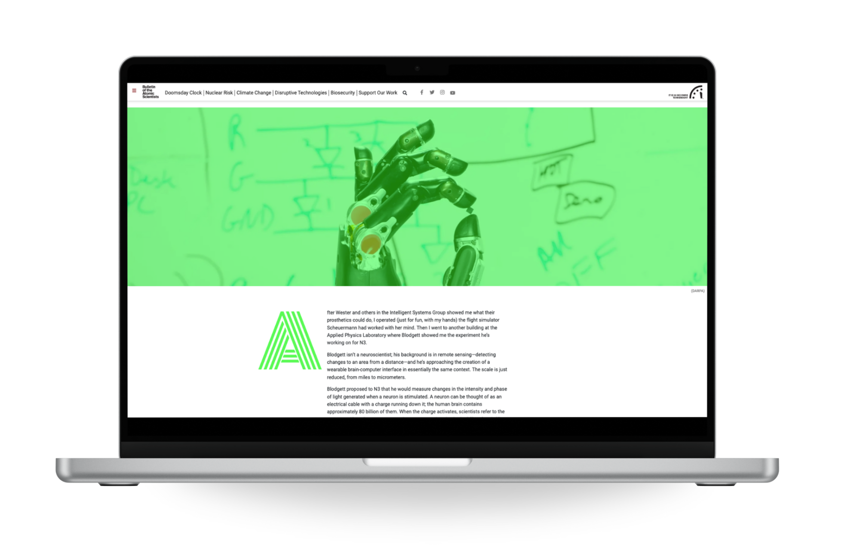
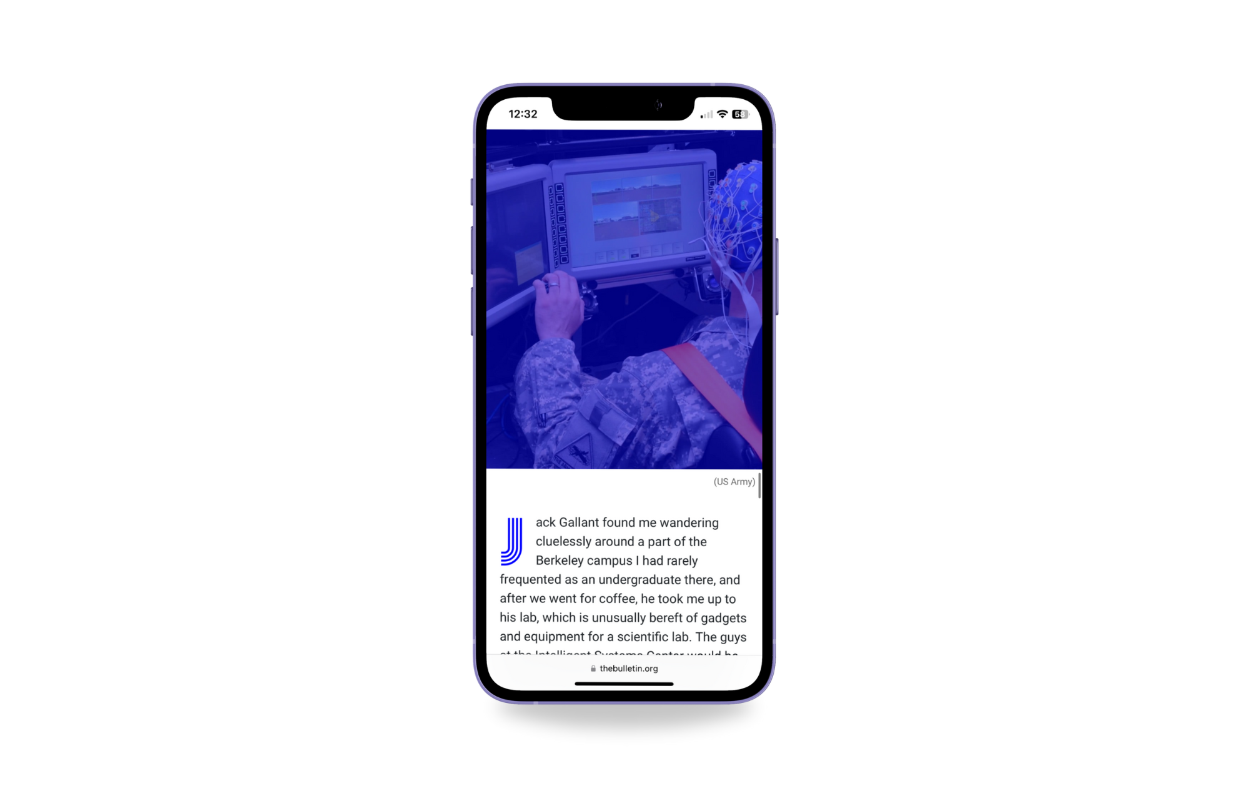
Award-winning coverage and design
The Bulletin has been recognized by the American Society of Magazine Editors twice in the National Magazine Awards for General Excellence.
In 2023, Paul Tullis won an AAAS Kavli Science Journalism Award for his Bulletin article, “Is the next pandemic brewing on the Netherlands’ poultry farms?”
In 2020, the Chicago Headline Club recognized the Bulletin for its cutting-edge web design with a Peter Lisagor Award for Best Design in a Specialty Publication.
The publication has won numerous other awards, including the Olive Branch Awards from the N.Y.U. Center for War, Peace, and the News Media.
This Bulletin multimedia design won the 2020 Peter Lisagor Award for Best Design in a Specialty Publication.
Notes:
The Bulletin has won numerous awards for its journalism and multimedia designs. Most recently, Paul Tullis won the Kavli Science Journalism Award for a feature article he did that examined if the next pandemic is brewing in poultry farms in the Netherlands.

Slide 5
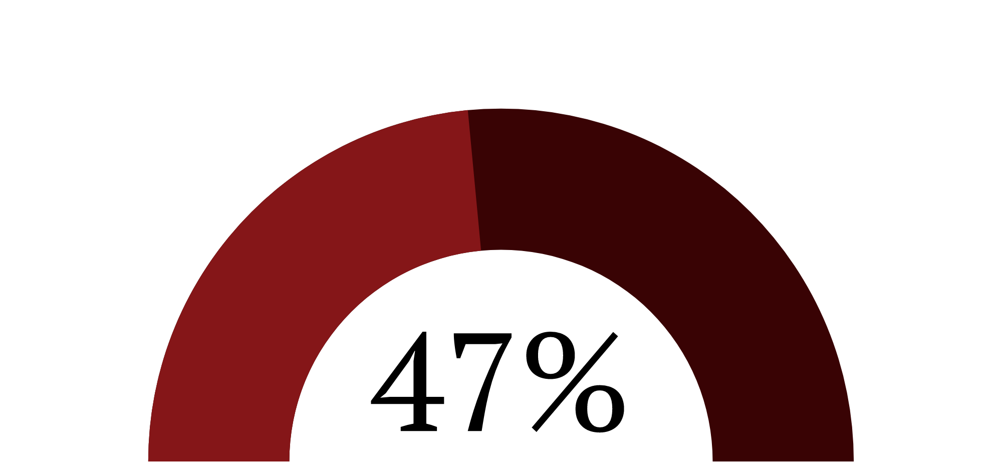
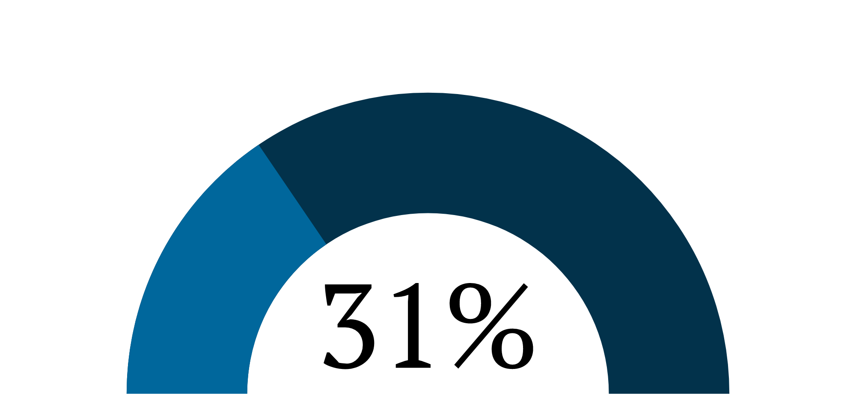
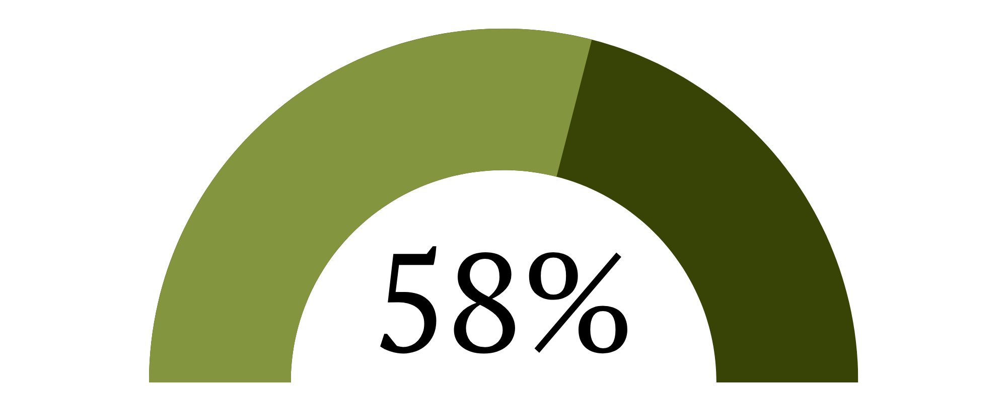
Our audience, at a glance
With nearly half of our audience under the age of 35 and 58% based outside of the US, the Bulletin has an expanding audience that largely skews male.
620,000
Of Bulletin readers are under
age 35.
Monthly average readers
Of Bulletin readers are women.
940,000
134,000+
Monthly average pageviews
Of Bulletin readers are based
outside the US.
Newsletter subscribers
Notes:
So the Bulletin currently has an expanding audience that skews largely male. Nearly half of our readers are under the age of 35 and almost 60% of our readers are based outside of the US. We average almost 1 million pageviews per month and over half a million monthly readers. Our newsletter subscriber base has also grown to an all-time high of over 134,000 subscribers.

Slide 6
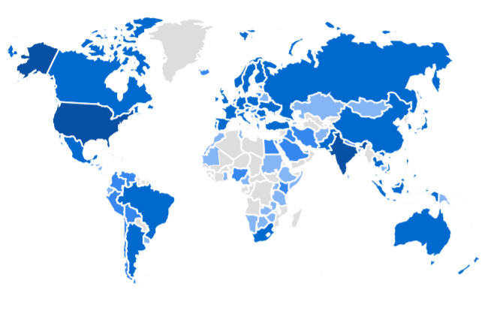
In 2024, the Bulletin is read worldwide.
Users have visited our site from all seven continents.
Country Users
United States 42%
India 26%
United Kingdom 6.2%
Canada 4%
Australia 2.5%
Pakistan 1.8%
Germany 1.2%
Notes:
So, in 2024, the Bulletin is read in almost every single country. Our highest readership is based in the US, followed by India, the United Kingdom, Canada, Australia, Pakistan, and Germany.

Slide 7
A trusted source of information for nearly 80 years
“The Bulletin has become widely recognized in America and abroad, both as the best and most complete source of authoritative information.”
Albert Einstein
Co-founder of the Bulletin’s Board of Sponsors, 1949
With early leadership including luminaries like Albert Einstein and J. Robert Oppenheimer, the Bulletin has upheld a legacy of elevating experts above the noise and providing perspectives that have shaped policy and politics.

Slide 8
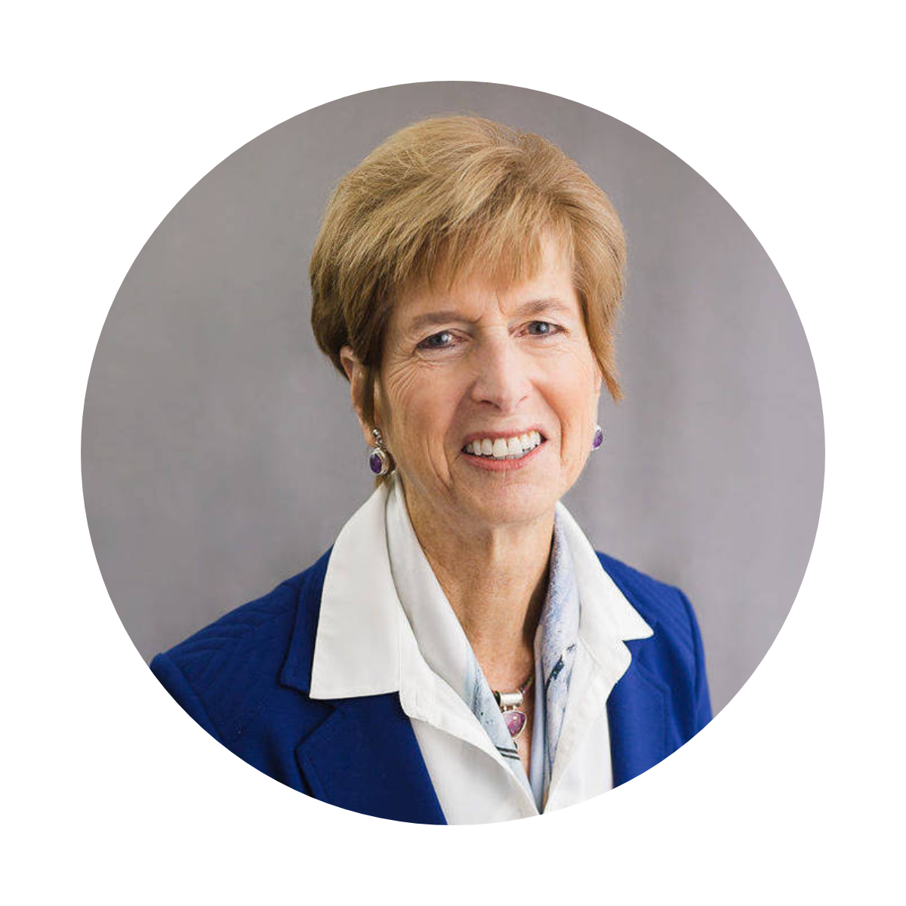
“The scientific transparency that the Bulletin provides is so necessary, especially in a time where climate misinformation runs rampant.”
“The Bulletin’s mission is as urgent today as it was when Albert Einstein and Robert Oppenheimer helped found it.”
Jasmine Banks
Bulletin contributor
Christine Todd Whitman
Former Administrator of the EPA
“Essential, informative, and trustworthy—the Bulletin helps readers understand man-made threats to human existence and how to help combat them.”
“In an era of misinformation, I trust I can go to the Bulletin for reliable information, diverse viewpoints, and scientific analysis.”
William J. Perry
Former US Secretary of Defense
Molly Hurley
Bulletin contributor

Slide 9
The Bulletin sells advertising on a sponsorship model
A comprehensive package includes:
1 week of display advertising on the Bulletin website, which averages around 940,000 pageviews
per month
1 week of newsletter sponsorship, with emails averaging a 23.42% open rate and 1.78% CTR

Slide 10
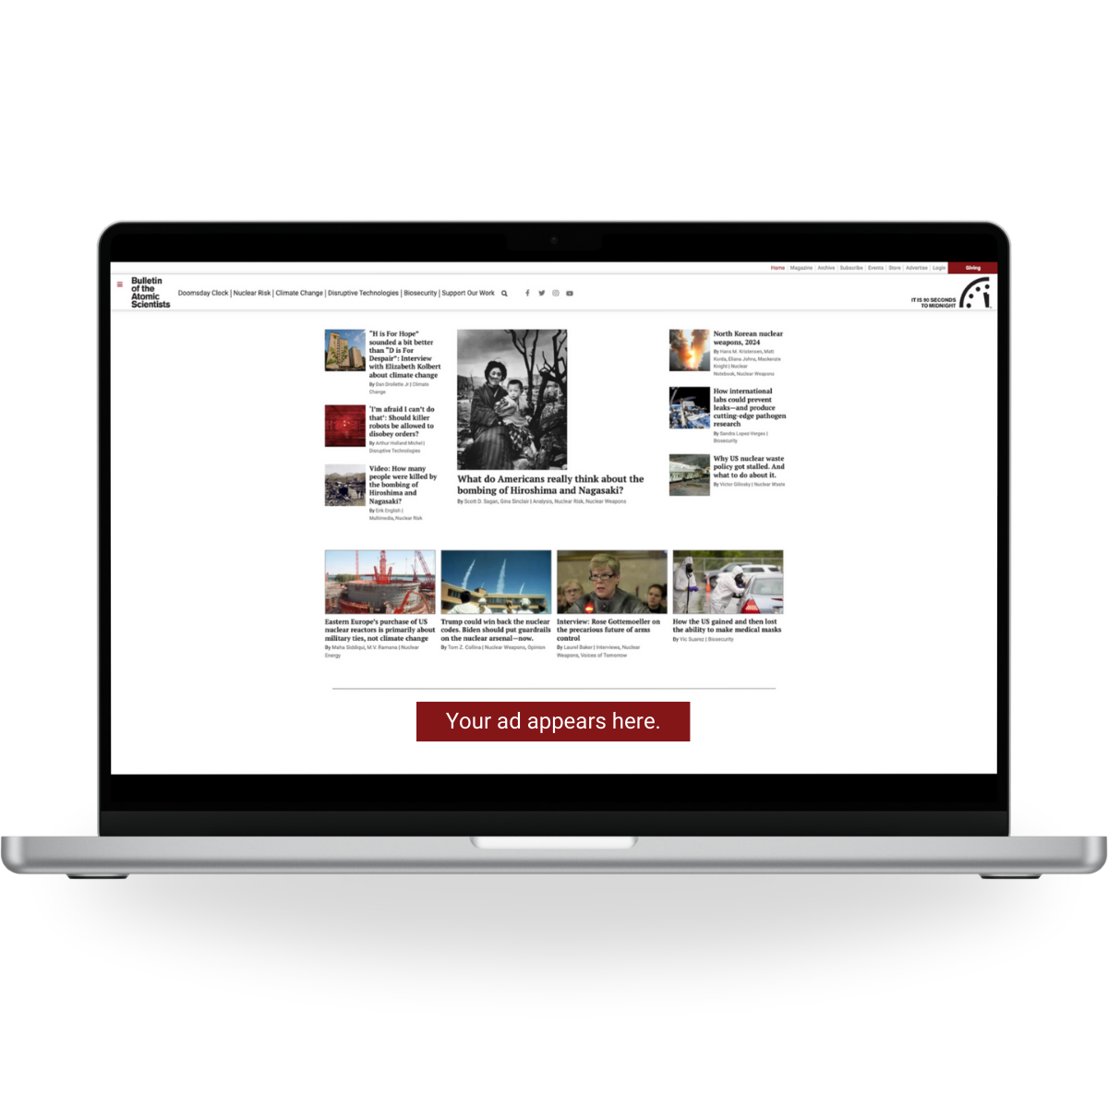
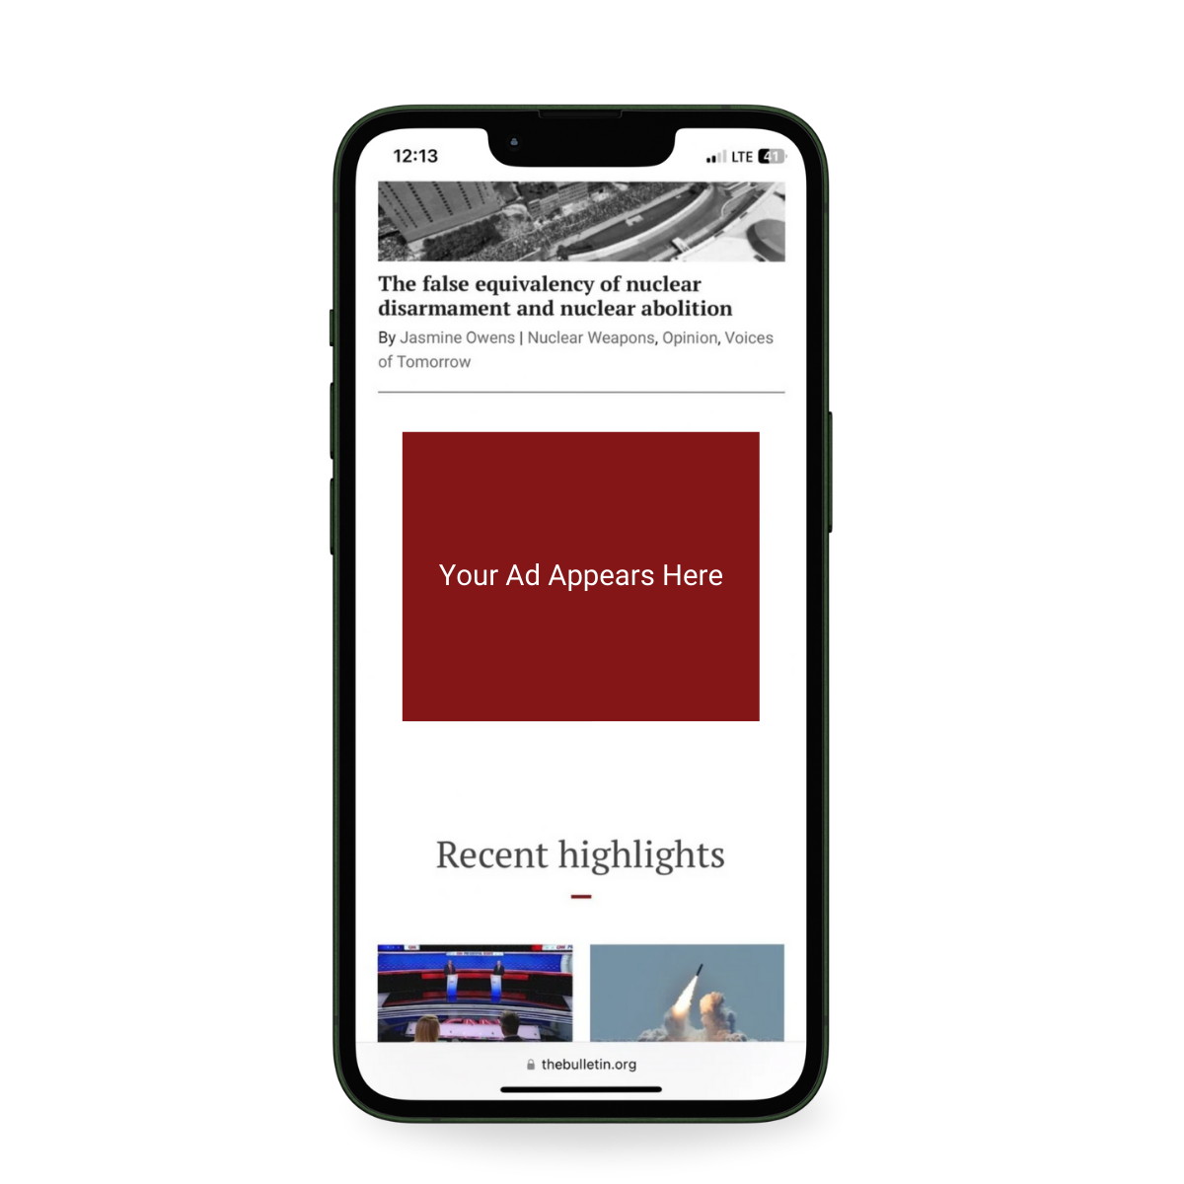
Desktop and mobile display advertising on the homepage

Slide 11
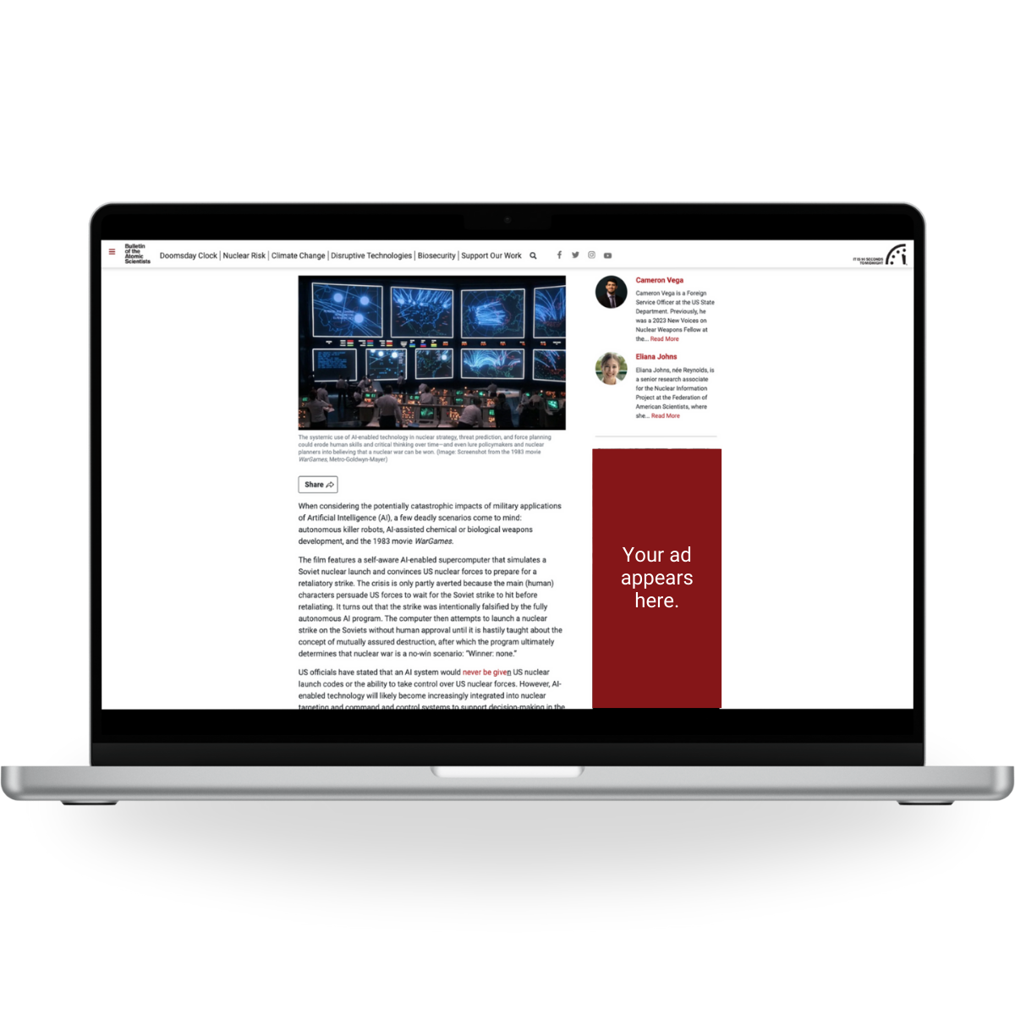
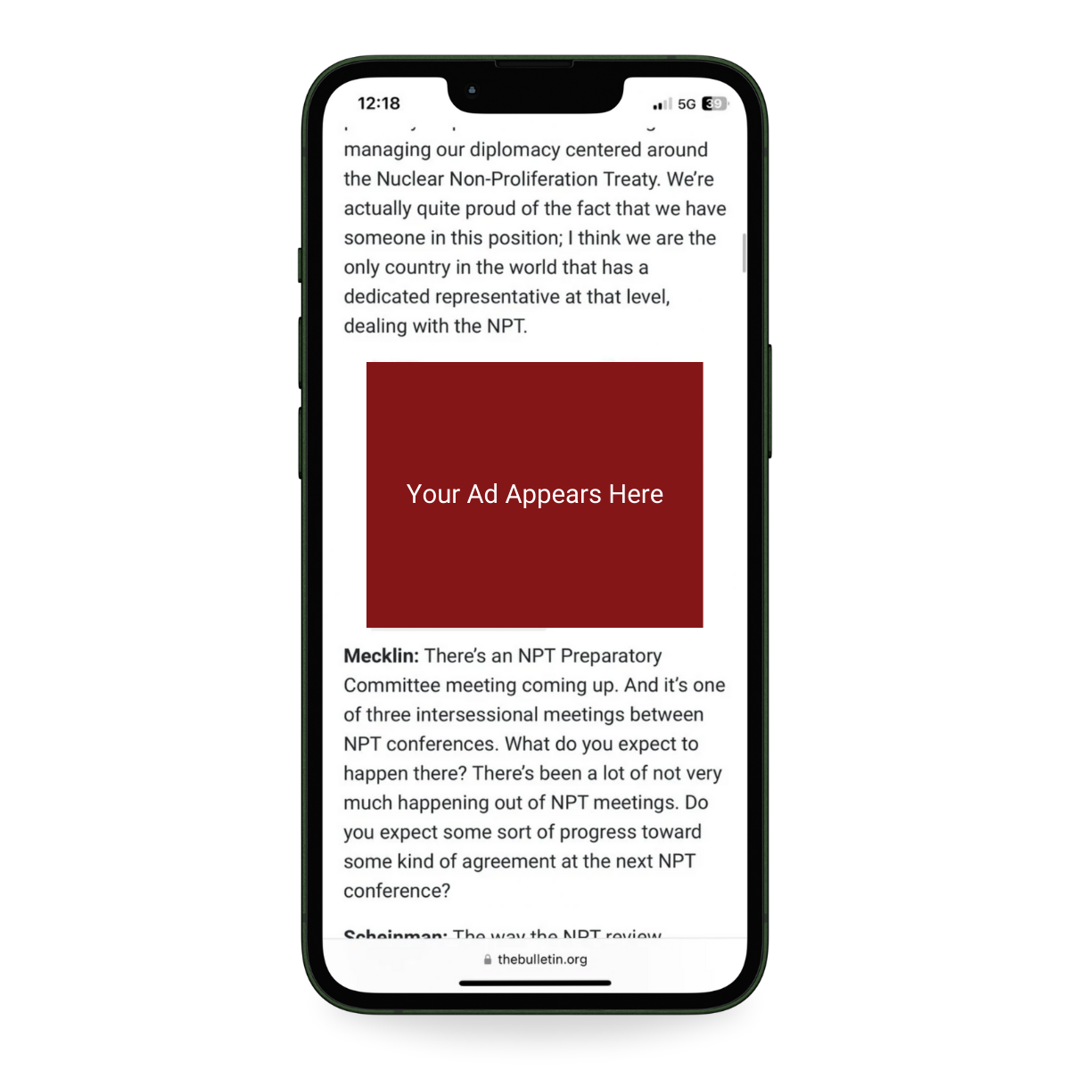
Desktop and mobile advertising in articles

Slide 12
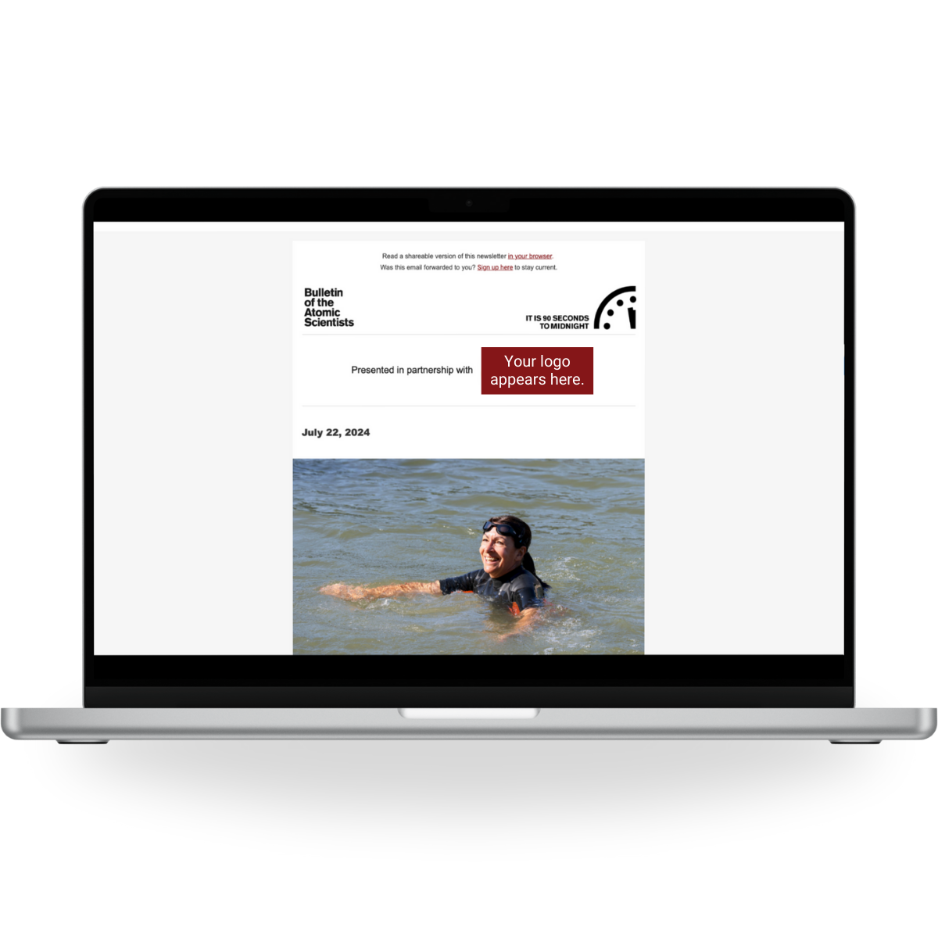
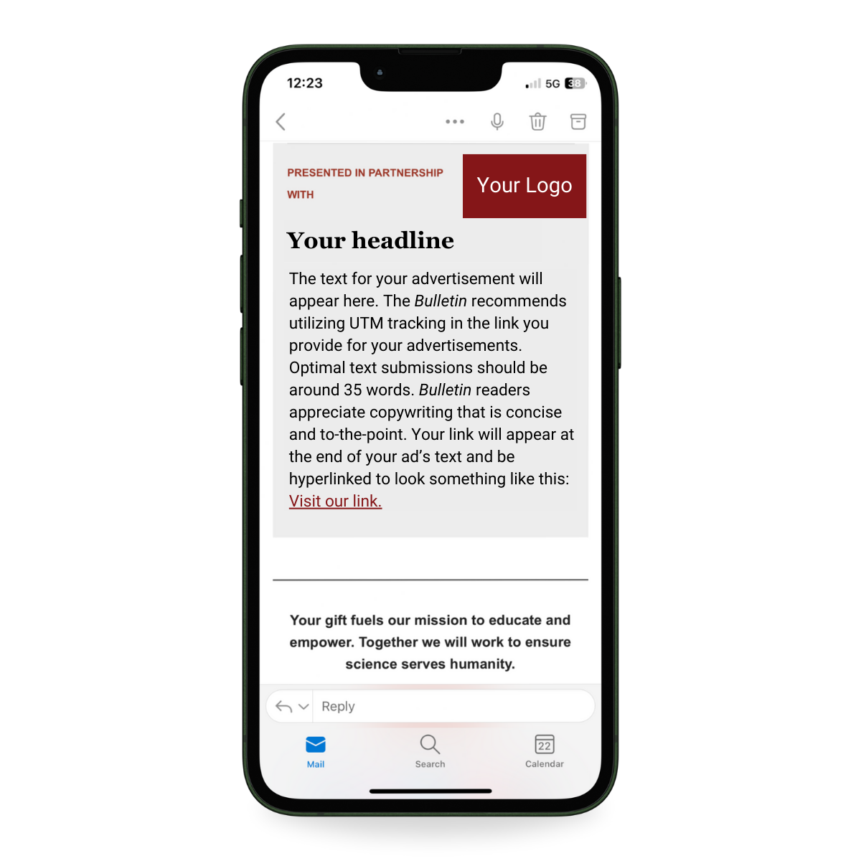
Newsletter sponsorship

Slide 13
Website Ad Creative
In addition to the creative below, please also provide a URL, preferably with UTM tracking information.
Location | Submission Size | Display size | File type | Notes
Desktop homepage | 1456 x 180px | 728 x 90px | jpg, png | Keeping font size at 13pt or higher helps ensure readability in this location. Adding a button reminds viewers that they can click on the ad.
Desktop article | 600 x 1200px | 300 x 600px | jpg, png | We suggest keeping font size no smaller than 28pt. Adding a button reminds viewers that they can click on the ad.
Mobile | 600 x 500px | 300 x 250px | jpg, png | We suggest keeping font size no smaller than 16pt. Adding a button reminds viewers that they can click on the ad.
*All ad copy must be approved by the Bulletin.

Slide 14
Newsletter Ad Creative
In addition to the creative below, please also provide a URL, preferably with UTM tracking information.
Location | Submission details | Display size | File type | Notes
Copywriting | Headline, 35 words, and a link | Reflects font style and sizing of the Bulletin‘s newsletter | email, pdf, docx | Copywriting that is concise, personable, and easily understood resonates well with the Bulletin’s large, diverse audience.
Logo placements | Minimum of 90px height, variable width | Minimum of 90px height, variable width | jpg, png | Your logo will appear at the top of the newsletter and above your copywriting in a content block below the quote of the day. Logos will appear on white and light gray backgrounds.
Graphic | 600 x 500px | 300 x 250px | jpg, png | Including a button reminds viewers that this ad is clickable.
*All ad copy must be approved by the Bulletin.

Slide 15
Questions or orders?
Email us at advertising@thebulletin.org. Rate sheets are available upon request.

